Slide 1
What is Sorting?
A sorting algorithm is used to arrange elements of an array/list in a specific order.

Slide 2
Bubble Sort
Bubble sort compares two adjacent elements and swaps them until they are in the intended order.

Slide 3
Bubble Sort
2
1
4
5
3

Slide 4
Bubble Sort
1
2
4
5
3

Slide 5
Bubble Sort
1
2
4
5
3

Slide 6
Bubble Sort
1
2
4
5
3

Slide 7
Bubble Sort
1
2
4
3
5

Slide 8
Bubble Sort
1
2
4
3
5

Slide 9
Bubble Sort
1
2
4
3
5

Slide 10
Bubble Sort
1
2
4
3
5

Slide 11
Bubble Sort
1
2
3
4
5

Slide 12
Bubble Sort
1
2
3
4
5

Slide 13
Bubble Sort
1
2
3
4
5

Slide 14
Bubble Sort
1
2
3
4
5

Slide 15
Bubble Sort
1
2
3
4
5

Slide 16
Bubble Sort
1
2
3
4
5

Slide 17
Bubble Sort
1
2
3
4
5
Sorting Finished!

Slide 18
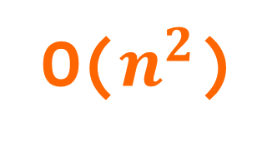
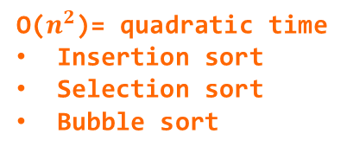
O($n^{2}$)
O(n log n)
O($n^{2}$)= quadratic time
Insertion sort
Selection sort
Bubble sort
O(n)
time
O(log n)
data

